Slide 1
Graphs Traversals
Notes:
https://www.cs.usfca.edu/~galles/visualization/DFS.html
https://www.cs.usfca.edu/~galles/visualization/BFS.html
https://www.youtube.com/watch?v=iaBEKo5sM7w
https://www.youtube.com/watch?v=QRq6p9s8NVg

Slide 2
Recap – Previous Lecture
General Terminology
Vertices, Edges, Connectedness, Path, Cycle etc.
SubTypes
DiGraphs, Trees
Representation techniques
Adjacency List, Adjacency Matrix

Slide 3
Recap – Previous Lecture
General Terminology
Vertices, Edges, Connectedness, Path, Cycle etc.
SubTypes
DiGraphs, Trees
Representation techniques
Adjacency List, Adjacency Matrix
a
b
a → b → d → null
b → e → null
c → a → d →null
d →e → null
e → null
e
d
c

Slide 4
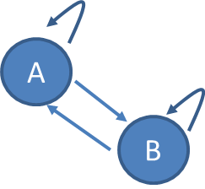
Implementing GraphNode & Graph
GraphNode // the single node (id of node is generic)
Members
T id
LinkedList<T> adjList
Constructor – GraphNode (T id)
Property (set/get) ID
void AddEdge(GraphNode to)
Add to.ID to adjList
LinkedList<T> GetAdjList()
Graph // the entire graph
Members: LinkedList<GraphNode> nodes
Constructor – graph
void AddNode(T id)
void AddEdge(T from, T to)
GraphNode GetNodeByID(T id)
bool IsEmptyGraph()
bool ContainsGraph(graphNode node)
bool IsAdjacent(GraphNode from, GraphNode to)
GraphNode
adjList
id
A
B
A
B
A
B

Slide 5
Implementing GraphNode & Graph
GraphNode // the single node (id of node is generic)
Members
T id
LinkedList<T> adjList
Constructor – GraphNode (T id)
Property (set/get) ID
void AddEdge(GraphNode to)
Add to.ID to adjList
LinkedList<T> GetAdjList()
Graph // the entire graph
Members: LinkedList<GraphNode> nodes
Constructor – graph
void AddNode(T id)
void AddEdge(T from, T to)
GraphNode GetNodeByID(T id)
bool IsEmptyGraph()
bool ContainsGraph(graphNode node)
bool IsAdjacent(GraphNode from, GraphNode to)
Graph
A
B
A
B
A
B
nodes

Slide 6
Recap: Stack
4
4
4
3
3
3
2
2
top =2
top =1
2
1
1
Joe
1
0
top =0
0
Fred
Fred
0

Slide 7
Recap: Stack
4
4
4
Joe
Fred
3
3
3
top =2
2
2
2
Joe
1
top =1
1
1
Fred
0
top =0
0
0
Fred

Slide 8

Recap: Queue
Items get added to the tail of the queue
Items get removed from the head of the Queue
Head
Tail
Fred
Jill
Gary
Frank
Joining Queue
enqueue
Leaving Queue
dequeue

Slide 9
This Lecture
Graph Traversals
Visit nodes that are in the graph
Depth First Search (DFS) and
Breadth First Search (BFS)
a
b
e
d
c

Slide 10
Many Applications
GPS / Navigation Systems.
city = graphs; landmarks = nodes; roads = edges
Use BFS to find the road to a destination
Computer Networks.
peer-peer networks.
Use BFS to locate the supplier of a document
Online Social Media
Individuals = nodes; friendship = connections;
Use BFS/DFS to find connections between individuals
(“friends of friends”)
Artificial Intelligence, problem solving

Slide 11
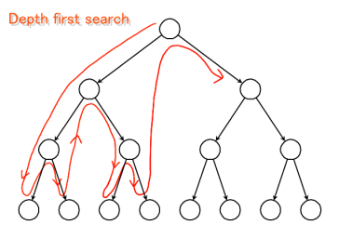
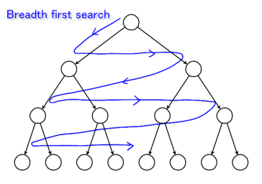
Graph Traversals
Depth First Search (DSF) & Breadth First Search (BFS)
- Visit nodes in graph (search for a goal node)
- Essential for game playing, problem solving

Slide 12
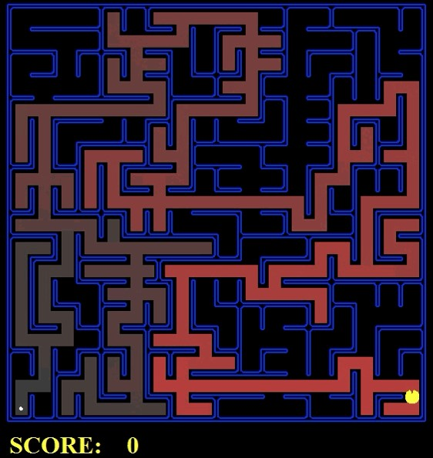
starting point
destination

Slide 13
graph

Slide 15
PacMan solved by DFS & BFS
brighter red = earlier exploration
Notes:
http://www.cs.princeton.edu/~andyz/pacmansearch

Slide 16
Depth-First Search

Slide 17
Depth-First Search
DFS follows the following rules:
Select an unvisited node x, visit it, and treat as the current node
Find an unvisited neighbor of the current node, visit it, and make it the new current node;
If the current node has no unvisited neighbors, backtrack to the its parent, and make that parent the new current node;
Repeat steps 3 and 4 until no more nodes can be visited.

Slide 18
Illustration of DFS
0
1
2
9
4
10
5
7
11
8
6
Graph G
DFS Tree

Slide 19
Illustration of DFS
0
1
0
2
9
4
10
5
7
Construct a tree that describes
how nodes are visited in the graph:
add an edge from x to y if
node y is visited after node x
11
8
6
Graph G
DFS Tree

Slide 20
Illustration of DFS
0
1
0
2
1
4
9
10
5
7
11
8
6
Graph G
DFS Tree

Slide 21
Illustration of DFS
0
1
0
2
1
4
4
9
10
5
7
11
8
6
Graph G
DFS Tree

Slide 22
Illustration of DFS
0
1
0
2
1
4
4
9
10
5
7
2
11
8
6
Graph G
DFS Tree

Slide 23
Illustration of DFS
0
1
0
2
1
4
4
9
10
5
7
2
11
8
5
6
Graph G
DFS Tree

Slide 24
Illustration of DFS
0
1
0
2
1
4
4
9
10
5
7
2
11
8
5
6
7
Graph G
DFS Tree

Slide 25
Illustration of DFS
0
1
0
2
1
4
4
9
10
5
7
2
11
8
5
6
7
Graph G
8
DFS Tree

Slide 26
Illustration of DFS
0
1
0
2
1
4
4
9
10
5
7
2
11
8
5
6
7
Graph G
8
DFS Tree
backtracking to 5

Slide 27
Illustration of DFS
0
1
0
2
1
4
4
9
10
5
7
2
11
8
5
6
7
6
Graph G
8
DFS Tree

Slide 28
Illustration of DFS
0
1
0
2
1
4
4
9
10
5
7
2
11
8
5
6
7
6
Graph G
8
DFS Tree
backtracking to 2

Slide 29
Illustration of DFS
0
1
0
2
1
4
4
9
10
5
7
2
11
8
5
9
6
7
6
Graph G
8
DFS Tree

Slide 30
Illustration of DFS
0
1
0
2
1
4
4
9
10
5
7
2
11
8
5
9
6
7
11
6
Graph G
8
DFS Tree

Slide 31
Illustration of DFS
0
1
0
2
1
4
4
9
10
5
7
2
11
8
5
9
6
7
11
6
Graph G
8
10
DFS Tree

Slide 32
Illustration of DFS
0
1
0
2
1
4
4
9
10
5
7
2
11
8
5
9
6
7
11
6
Graph G
8
10
DFS Tree

Slide 33
Illustration of DFS
0
1
0
2
1
4
4
9
10
5
7
2
11
8
5
9
6
7
11
6
Graph G
8
10
DFS Tree

Slide 34
Illustration of DFS
0
1
0
2
1
4
4
9
10
5
7
2
11
8
5
9
6
7
11
6
Graph G
8
10
DFS Tree
If not possible then backtrack : last visited – first to backtrack

Slide 35
Illustration of DFS
0
1
0
2
1
4
4
9
10
5
7
2
11
8
5
9
6
7
11
6
Graph G
8
10
DFS Tree
If not possible then backtrack : last visited –
first to backtrack
use stack to store nodes and do the backtracking

Slide 36
Implementation: DFS
Depth First algorithm
start at any node : Current
Repeat
push all (new) adjacent nodes to Stack: ToVisit
Current = Pop top node from stack
until no new node can be reached
depth-first pseudocode
visited = {} : list
toVisit = {} : stack
select start node and push on toVisit
while Not (toVisit = {})
current = top toVisit
pop toVisit
add current to visited
for each adjacent node of current
if both toVisit and visited do not contain node then
push node on toVisit
end for
end while
a
b
e
c
d
stack
current | visited | toVisit
 | {} | {a}
a | {a} | {b,d}
b | {a,b} | {e,d}
e | {a,b,e} | {d}
d | {a,b,e,d} | {c}
c | {a,b,e,d,c} | {}

Slide 37
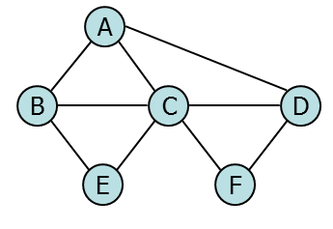
Another Example: DFS
current | visited | toVisit
 | {} | {a}
a | {a} | {b,c,d}
b | {a,b} | {e,c,d}
e | {a,b,e} | {c,d}
c | {a,b,e,c} | {f,d}
f | {a,b,e,c,f} | {d}
d | {a,b,e,c,f,d} | {}

Slide 38
Breadth-First Search

Slide 39
Breadth-First Search
BFS follows the following rules:
Select an unvisited node x, and make it the current level.
From each node z in the current level visit all the unvisited neighbors of z. The newly visited nodes from this level form a new level that becomes the next current level.
Repeat step 2 until no more nodes can be visited.

Slide 40
Illustration of BFS
0
1
2
9
4
10
5
7
11
8
6
Graph G
BFS Tree

Slide 41
Illustration of BFS
0
1
0
2
current level
9
4
10
5
7
11
8
6
Graph G
BFS Tree

Slide 42
Illustration of BFS
0
1
0
2
2
9
4
10
5
7
constructs new level
11
8
6
Graph G
BFS Tree

Slide 43
Illustration of BFS
0
1
0
2
2
1
4
9
10
5
7
constructs new level
11
8
6
Graph G
BFS Tree

Slide 44
Illustration of BFS
0
1
0
2
4
2
1
4
9
10
5
7
constructs new level
11
8
6
Graph G
BFS Tree

Slide 45
Illustration of BFS
0
1
0
2
4
2
1
4
9
new level
10
5
7
11
8
6
Graph G
BFS Tree

Slide 46
Illustration of BFS
0
1
0
2
4
2
1
4
9
10
5
7
constructs new level
11
8
6
Graph G
backtracking to node 2
BFS Tree

Slide 47
Illustration of BFS
0
1
0
2
4
2
1
4
9
9
10
5
7
constructs new level
11
8
6
Graph G
BFS Tree

Slide 48
Illustration of BFS
0
1
0
2
4
2
1
4
9
9
10
10
5
7
constructs new level
11
8
6
Graph G
BFS Tree

Slide 49
Illustration of BFS
0
1
0
2
4
2
1
4
9
5
9
10
10
5
7
constructs new level
11
8
6
Graph G
BFS Tree

Slide 50
Illustration of BFS
0
1
0
2
4
2
1
4
9
5
9
10
10
5
7
constructs new level
11
8
6
Graph G
BFS Tree
backtrack to node 1

Slide 51
Illustration of BFS
0
1
0
2
4
2
1
4
9
5
9
10
10
5
7
constructs new level
11
8
6
Graph G
BFS Tree
backtrack to node 4

Slide 52
Illustration of BFS
0
1
0
2
4
2
1
4
9
5
9
10
10
5
7
new level
11
8
6
Graph G
BFS Tree

Slide 53
Illustration of BFS
0
1
0
2
4
2
1
4
9
5
9
10
10
5
7
11
8
constructs new level
6
Graph G
BFS Tree
backtracking to 9

Slide 54
Illustration of BFS
0
1
0
2
4
2
1
4
9
5
9
10
10
5
7
11
8
11
6
constructs new level
Graph G
BFS Tree

Slide 55
Illustration of BFS
0
1
0
2
4
2
1
4
9
5
9
10
10
5
7
11
8
11
6
constructs new level
Graph G
BFS Tree
backtracking to 5

Slide 56
Illustration of BFS
0
1
0
2
4
2
1
4
9
5
9
10
10
5
7
11
8
6
11
6
constructs new level
Graph G
BFS Tree

Slide 57
Illustration of BFS
0
1
0
2
4
2
1
4
9
5
9
10
10
5
7
11
8
6
7
11
6
constructs new level
Graph G
BFS Tree

Slide 58
Illustration of BFS
0
1
0
2
4
2
1
4
9
5
9
10
10
5
7
11
8
6
7
8
11
6
constructs new level
Graph G
BFS Tree

Slide 59
Illustration of BFS
0
1
0
2
4
2
1
4
9
5
9
10
10
5
7
11
8
6
7
8
11
6
constructs new level
Graph G
BFS Tree
backtracking to 10

Slide 60
Illustration of BFS
0
1
0
2
4
2
1
4
9
5
9
10
10
5
7
11
8
6
7
8
11
6
Graph G
new level
BFS Tree

Slide 61
Illustration of BFS
0
1
0
2
4
2
1
4
9
5
9
10
10
5
7
11
8
6
7
8
11
6
new level
Graph G
Backtracking: The first node visited in each level is the first node from which to proceed to visit new nodes.
BFS Tree

Slide 62
Illustration of BFS
0
1
0
2
4
2
1
4
9
5
9
10
10
5
7
11
8
6
7
8
11
6
new level
Graph G
Backtracking: The first node visited in each level is the first node from which to proceed to visit new nodes.
Use a queue
BFS Tree

Slide 63
Illustration of BFS
0
1
2
4
1 Traversal Away…
5
9
10
2 Traversals Away…
6
7
8
11
3 Traversals Away…
Ideal for calculating Closeness Centrality!

Slide 64
Implementation: BFS
Breadth First algorithm
start at any node : Current
Repeat
Enqueue all (new) adjacent nodes to Queue: ToVisit
Current = dequeue ToVisit
until no new node can be reached
breadth-first pseudocode
visited = {} : list
toVisit = {} : queue
select start node and enqueue to toVisit
while Not (toVisit = {})
current = head toVisit
deQueue toVisit
add current to visited
for each adjacent node of current
if both toVisit and visited do not contain node then enqueue node on toVisit
end for
end while
As DFS but to_visit is now a Queue not a stack
a
b
e
c
d
queue
current | visited | toVisit
 | {} | {a}
a | {a} | {b,d}
b | {a,b} | {d,e}
d | {a,b,d} | {e,c}
e | {a,b,d,e} | {c}
c | {a,b,d,e,c} | {}

Slide 65
Another Example: BFS
current | visited | toVisit
 | {} | {a}
a | {a} | {b,c,d}
b | {a,b} | {c,d,e}
c | {a,b,c} | {d,e,f}
d | {a,b,c,d} | {e,f}
e | {a,b,c,d,e} | {f}
f | {a,b,c,d,e,f} | {}

Slide 66
Implementation (C#): BFS
public void BreadthFirstTraverse(T startID, ref List<T> visited)
{
LinkedList<T> adj;
Queue<T> toVisit = new Queue<T>();
toVisit.Enqueue(startID);
T currentID;
while (toVisit.Count != 0)
{
// get ID of current node from toVisit (use “dequeue”)
// store ID of current node in “visited”
// get adjacency list of the current node
// add to toVisit (use “enqueue”) each node n in the adjacency list
// (only if n is not in “visited” and not in “toVisit”)
}
}

Slide 67
Graph Traversals / Searches
Breadth-first
Uses a Queue
visit all vertices 1 edge away then 2 away etc. from start
Goes deep slowly, leaves deep nodes till later
Useful if goal is near start node
a
1
2
4
b
3
c
d
5
e
f
g
7
6
8
h

Slide 68
Graph Traversals / Searches
Breadth-first
Uses a Queue
visit all vertices 1 edge away then 2 away etc. from start
Goes deep slowly, leaves deep nodes till later
Useful if goal is near start node
Depth-first
Uses a Stack
Traverse graph from one side to the other
Goes deep quickly, leaving shallow nodes till later
Useful if goal is likely to be deeper
a
1
a
1
2
8
2
4
b
5
c
d
b
3
c
d
3
e
f
g
6
5
e
f
g
7
4
7
6
8
h
h

Slide 69
Summary
Graphs
Representation schemes
Adjacency List
Adjacency Matrix
2 classes Graph, GraphNode (possibly Edge)
Terminology : Connected, trivial path etc
Traversal techniques
Depth First
Breadth First

